Slide 1


History
Vikings and Anglo-Saxons
Year One
History | LKS2 | Vikings and Anglo-Saxons | The Last Anglo-Saxon Kings | Lesson 6

Slide 2
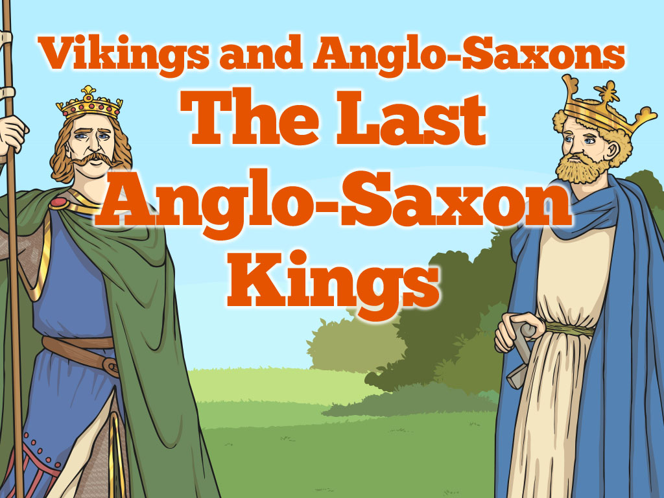


Slide 3
Aim
I can explain how the last Anglo-Saxon kings shaped Britain.
Success Criteria
I can identify and order Anglo-Saxon kings on a timeline.
I can explain key aspects of the reign of the last Anglo-Saxon kings.
I can distinguish between historically accurate and inaccurate events.

Slide 4

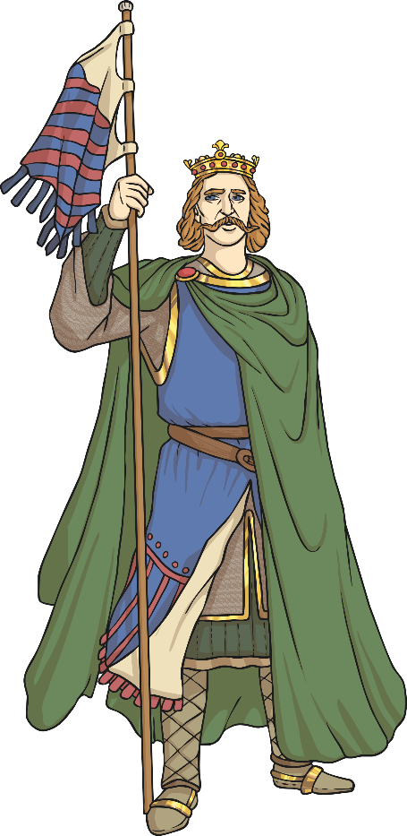
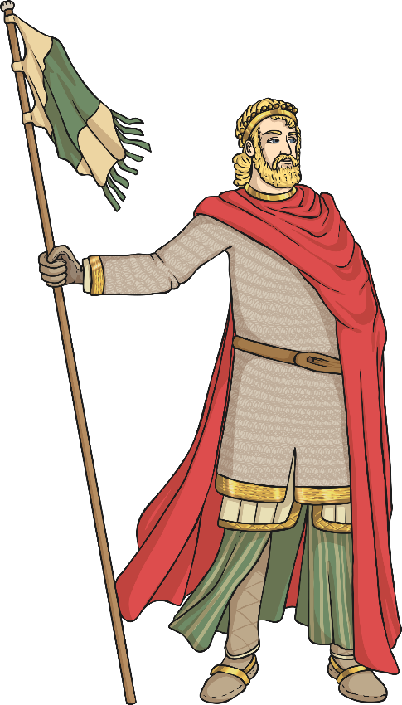
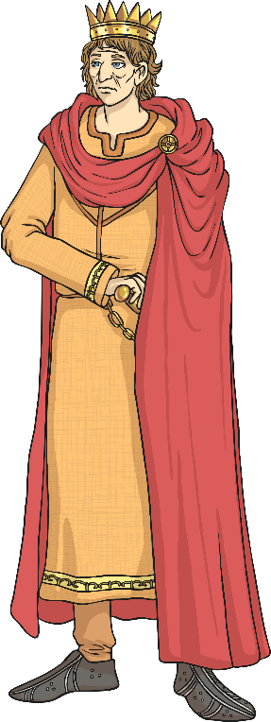
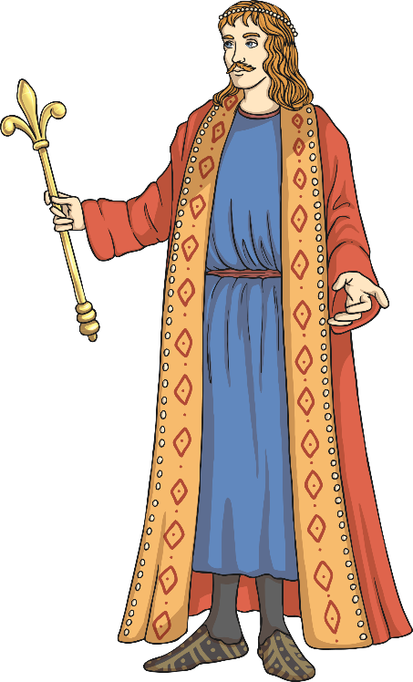
Recap
With the other children in your group, discuss what you think are the most important or memorable facts you have learnt about the history of the Vikings and the Anglo-Saxon kings who ruled in England during this period.
Jot down the kings’ names and any facts you are able to recall.
Be ready to give feedback to the rest of the class.

Slide 5
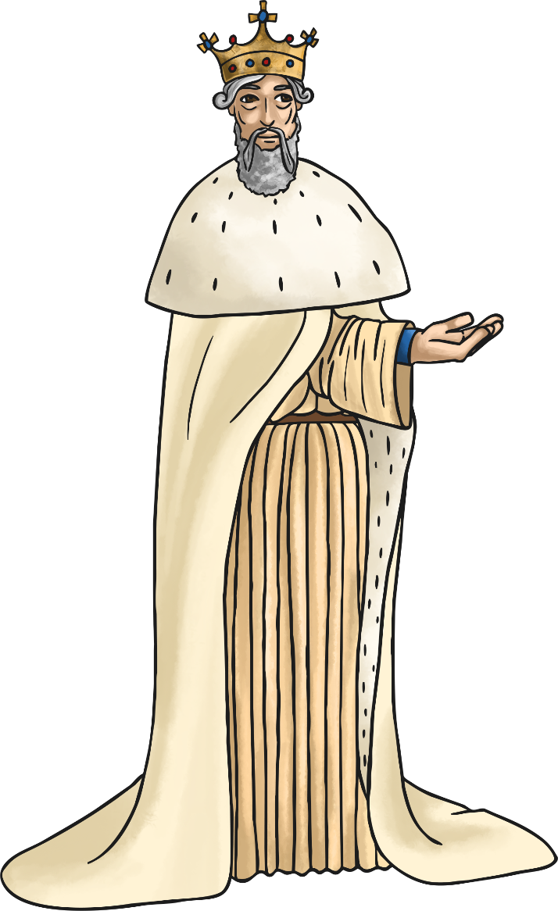
Edward the Confessor
In 1042AD, Edward the Confessor became king of England after he was invited to return to Britain from exile in Normandy. He ruled until his death in 1066AD.
Edward was the son of King Ethelred the Unready and his second wife Emma and the half brother of Hardicanute. He was known as ‘The Confessor’ because he led a very religious life and he was a kind and thoughtful king. Edward built Westminster Abbey.
Edward married a woman called Edith in 1045AD. She was the daughter of the Earl of Wessex, Godwin. Edward and Edith did not have any children.

Slide 6

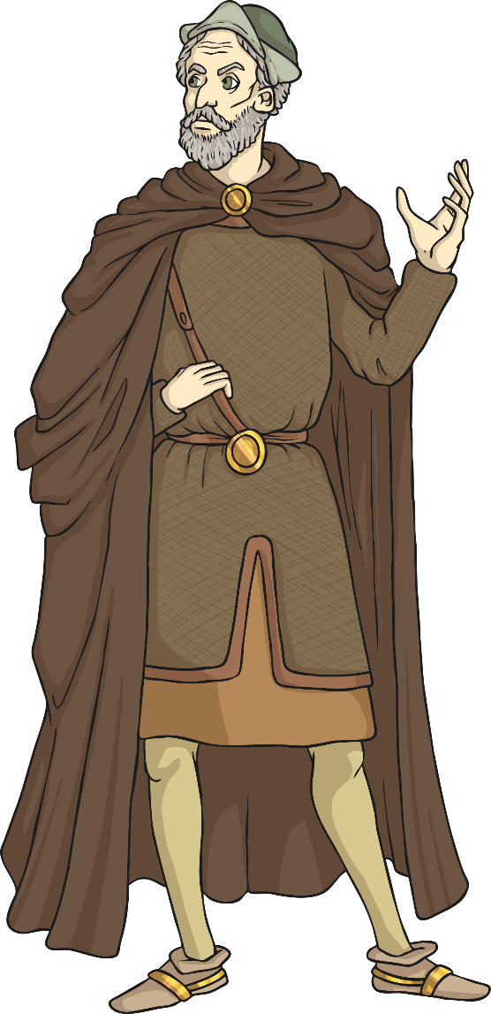
Godwin of Wessex
Edward the Confessor had strong links with Normandy. He had grown up there and had the support of William, the Duke of Normandy.
Some people in Britain did not like this close relationship. Between 1050 and 1052AD Godwin, Earl of Wessex’s army tried to push Edward off the throne, but Edward’s army defeated Godwin and Edward sent him out of the country.
However, Edward did form a good relationship with Godwin’s son, Harold, who became king for a short time after Edward’s death.
How do you think Edward might have felt about returning to England to become king?
Can you think of 3 positive and 3 negative reasons?

Slide 7

Harold II
Edward the Confessor died in 1066AD and Harold became king. He was a strong leader and he fought hard to keep the throne.
In 1066, Harold’s army marches up to Yorkshire to stop Harald of Norway and his huge army from invading. Harold’s men killed Harald and thousands of his Norwegian soldiers in the Battle of Stamford Bridge.
However, only weeks later, Harold had to fight again! William, the Duke of Normandy, thought he should be king of England and so he and his army came to battle against Harold. Harold and his troops marched down from Stamford Bridge to face the Normans in the Battle of Hastings.

Slide 8
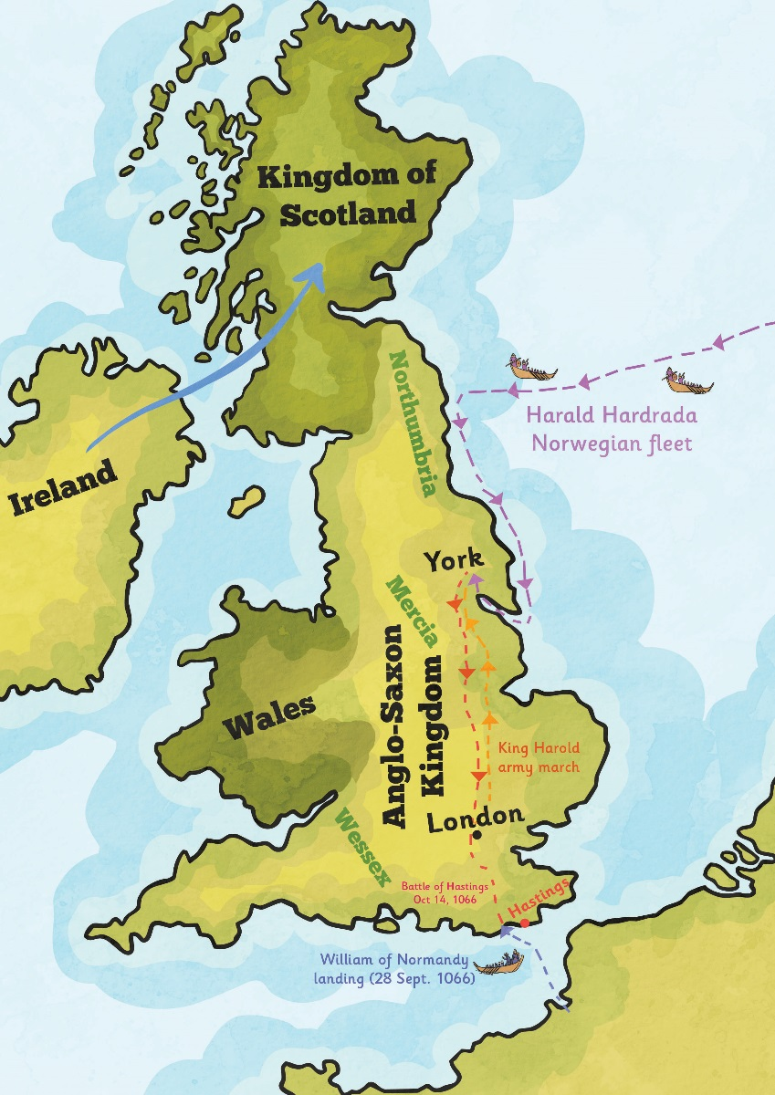
The Battle of Hastings
The Battle of Hastings is known as a significant historical event which shaped the future of Britain. King Harold and his army fought against King William of Normandy in the battle which took place on 14th October 1066.
The battle took place in a place called Battle in East Sussex, about 7 miles away from Hastings and lasted from dawn until dusk. It ended when Harold was shot through the eye with an arrow. His troops retreated and William and his soldiers were victorious.
What do you think it would have been like to be a soldier fighting in the Battle of Hastings?
Why do you think Harold’s troops retreated when he was killed?

Slide 9


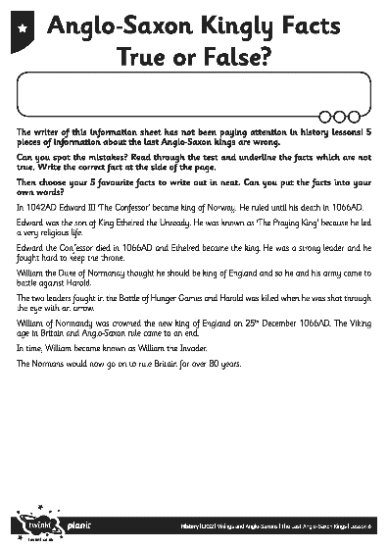
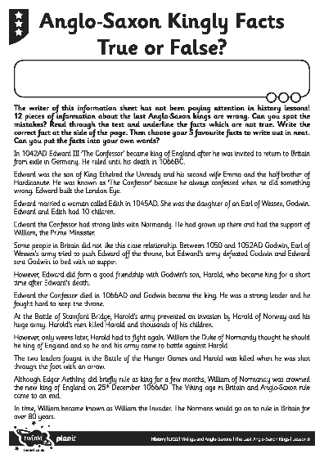
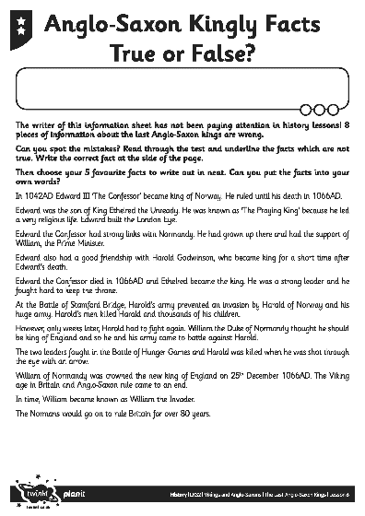
Kingly Facts: True or False?
Read through the information about the last Anglo-Saxon kings on your activity sheet. The writer of the information sheet has not been paying attention in history lessons and several of the facts are wrong!
Activity
Can you spot the mistakes? Read through the text and underline the facts which are not true.
Write the correct fact at the side of the page.
Then choose your 5 favourite facts to write out in neat. Can you put the facts into your own words?

Slide 10

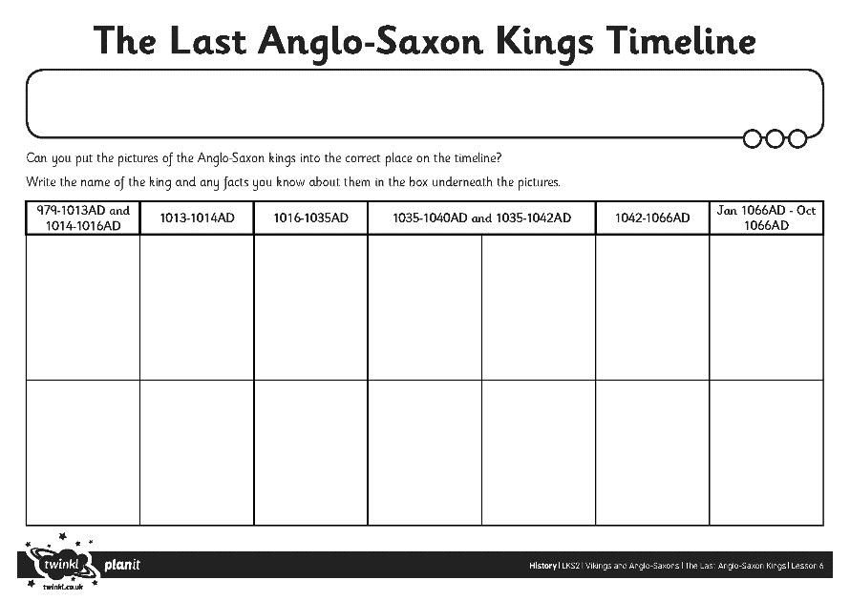
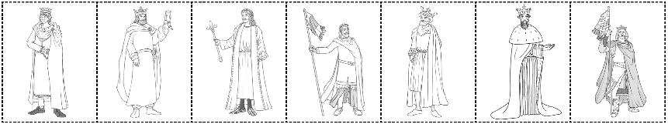
The Last Anglo-Saxon
Kings Timeline
Activity
Can you work with a partner to put the pictures of the Anglo-Saxon kings into the correct place on the timeline?
Then write the name of the king and any facts you know about them in the box underneath the pictures.

Slide 11
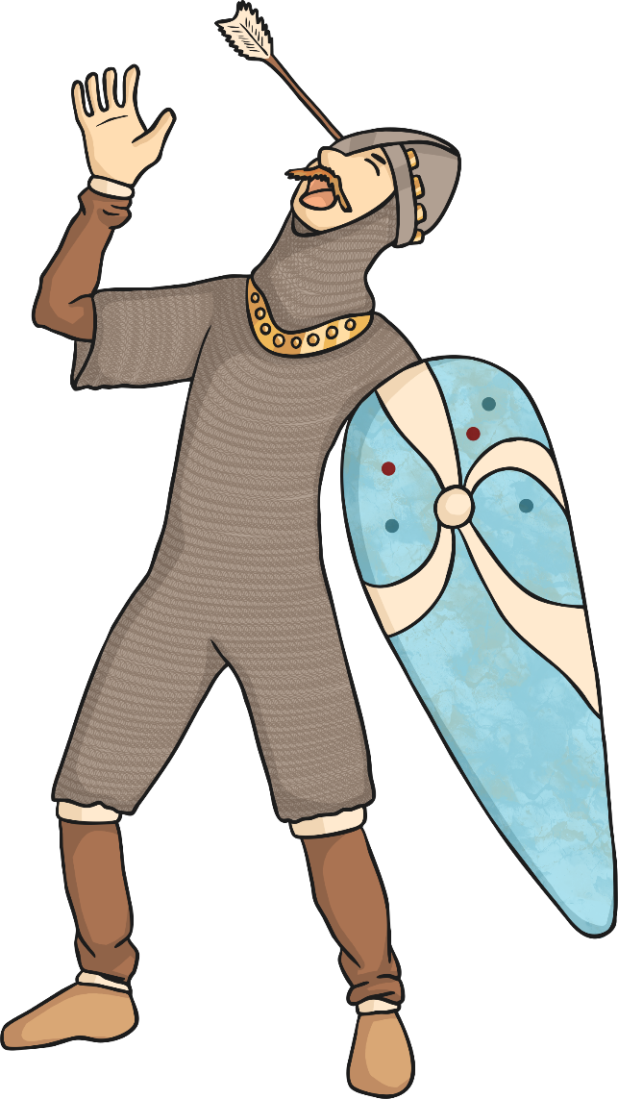
The End of an Era
Although Edgar Aethling did briefly rule as king for a few months, William of Normandy was crowned the new king of England on 25th December 1066AD. The Viking age in Britain and Anglo-Saxon rule came to an end.
In time, William became known as William the Conqueror.
The Normans would now go on to rule in Britain for over 80 years.
Why do you think William became known as ‘William the Conqueror’?
Who would think this is a good title to earn and who would think it was a bad one?

Slide 12

Aim
I can explain how the last Anglo-Saxon kings shaped Britain.
Success Criteria
I can identify and order Anglo-Saxon kings on a timeline.
I can explain key aspects of the reign of the last Anglo-Saxon kings.
I can distinguish between historically accurate and inaccurate events.

