Slide 1
History
Vikings and Anglo-Saxons
Year One
History | LKS2 | Vikings and Anglo-Saxons | Anglo-Saxon Kings | Lesson 2

Slide 3
Aim
I can compare the significance of some Anglo-Saxon kings during the Viking period.
Success Criteria
I can identify key facts about some Anglo-Saxon kings.
I can demonstrate my understanding of the significance of some Anglo-Saxon kings.
I can compare the similarities and differences between some Anglo-Saxon kings.

Slide 4
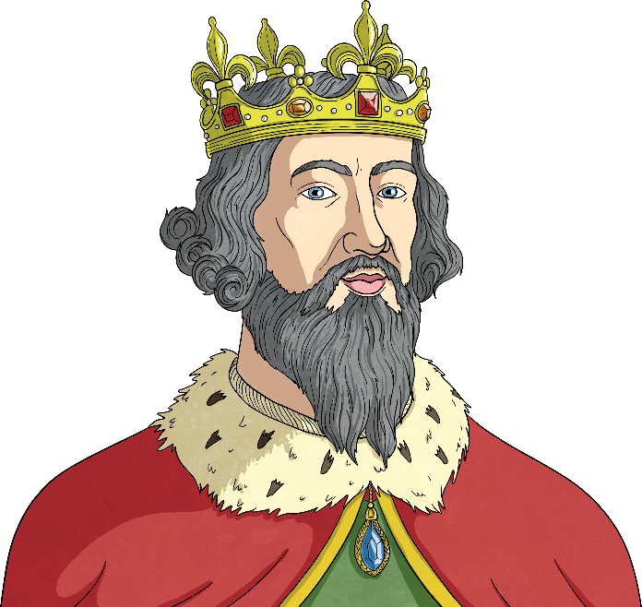
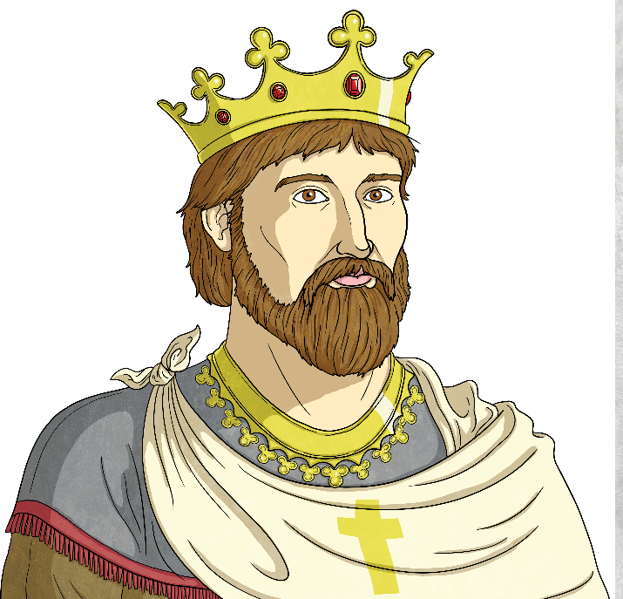
Anglo-Saxon Kings
With your partner, discuss what you already know about the Anglo-Saxons and their kings.
Do you know the names of any Anglo-Saxon kings or where they ruled?
Is there anything or anyone you would like to find out about in more detail?

Slide 5
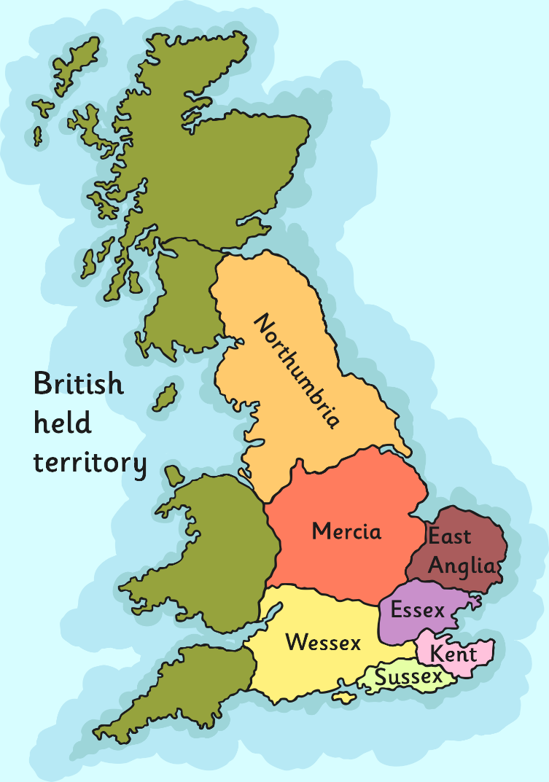
Kingdoms
The kings of Anglo-Saxon Britain each ruled their own kingdom and the people in it. They also controlled their own army. Kings constantly fought to control other kingdoms and defend their land. They were known as warrior-kings.
When the Anglo-Saxons first settled in Britain there were seven kingdoms. However, by AD 878 there was only one kingdom left; Wessex, ruled by King Alfred the Great. The other kingdoms had been overrun by the Vikings who established their own kingdoms.

Slide 6
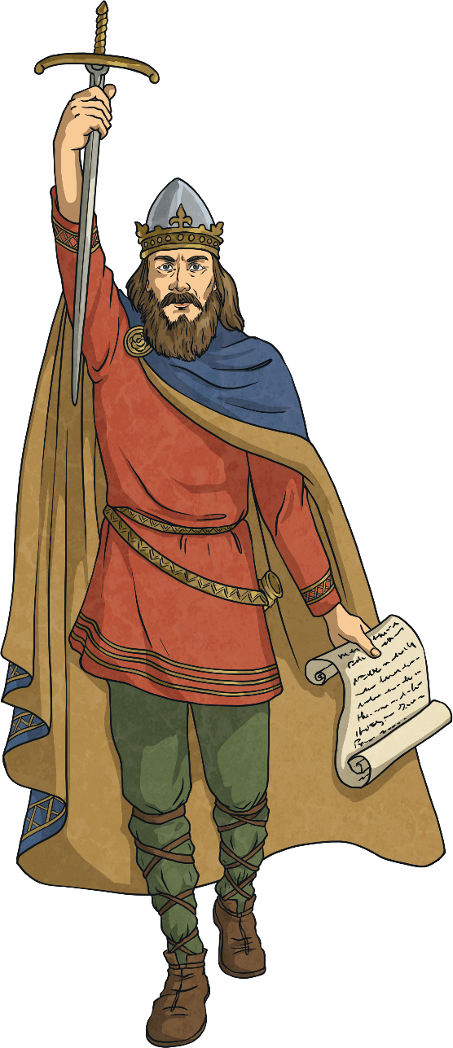
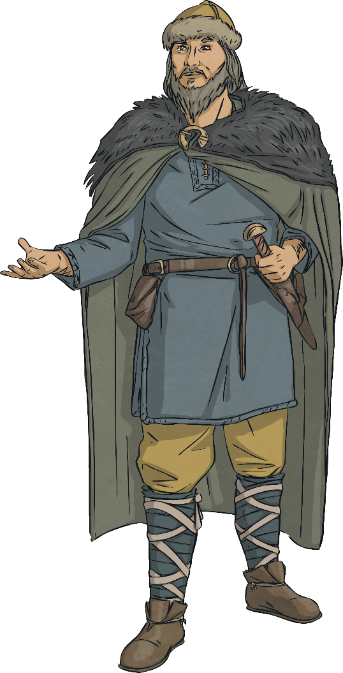
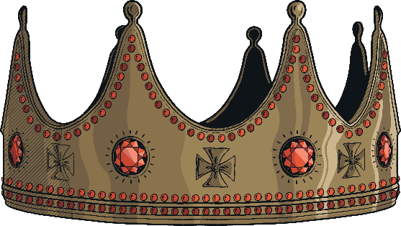
Kings Vs The Vikings
Some of the Anglo-Saxon Kings are well known for the resistance they put up against the Vikings. They fought hard to keep control of their land and tried to push the Vikings out.
One of the best known Anglo-Saxon kings is King Alfred the Great. He is the only British monarch to have the title ‘great’ in his name.

Slide 7
King Alfred the Great
So, what made King Alfred so great?
King Alfred is credited with being the first Anglo-Saxon king to defeat the Vikings in battle and buy the people of Britain some peace from them.
Alfred became king in AD 871. He reigned until his death in AD 899.
In AD 878 the Vikings invaded Wessex and forced King Alfred into hiding. However, Alfred was not prepared to give up.
Later in AD 878, King Alfred and his small band of followers defeated the Vikings at the Battle of Edington. The Battle of Edington was reported as a fierce and bloody event and King Alfred was reported to charge into battle like a wild boar. King Alfred and is men drove back the attacking Vikings who surrendered. It is said that the Viking leader of this battle, King Guthrum, immediately converted to Christianity and was baptised by King Alfred himself.

Slide 8
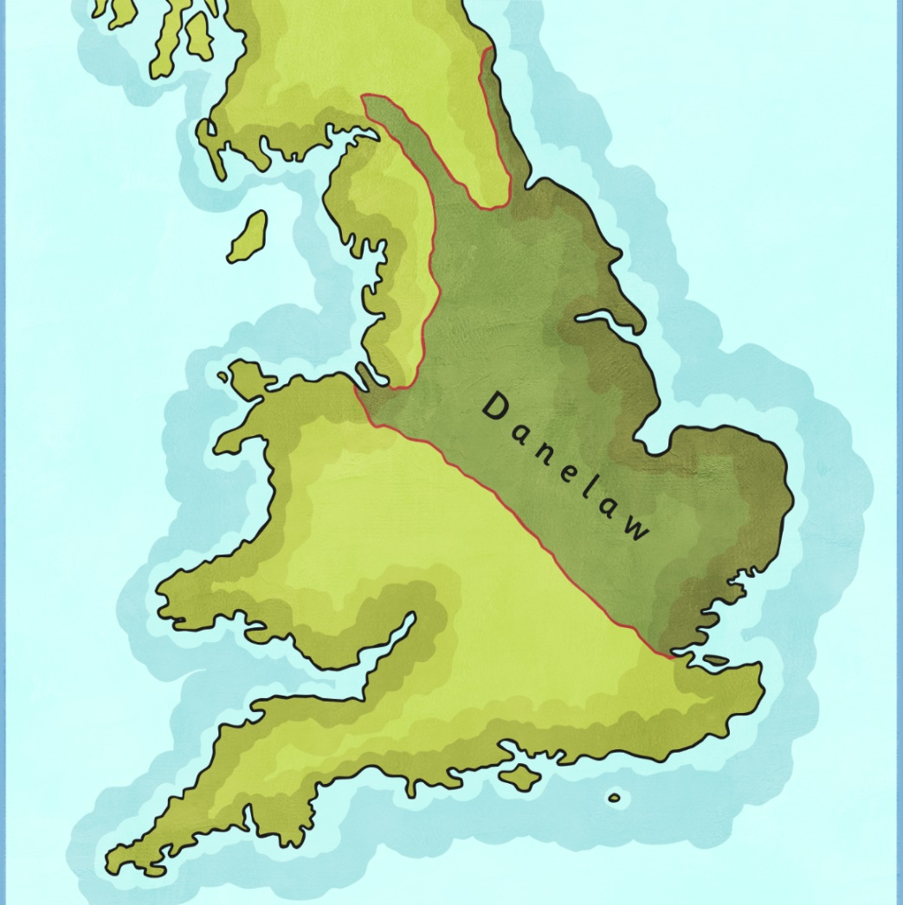
Danelaw
King Alfred knew that although he had been able to stop the Vikings from taking over in Wessex, he would never be able to control them in the rest of England.
In AD 886, he made a deal with King Guthrum and established a treaty which gave the Vikings control over northern and eastern England, an area which later became known as Danelaw.
King Alfred got to keep control over Wessex and he also got to rule over West Mercia and Kent.
This arrangement helped to establish more peaceful relationships between the English and the Vikings.

Slide 9
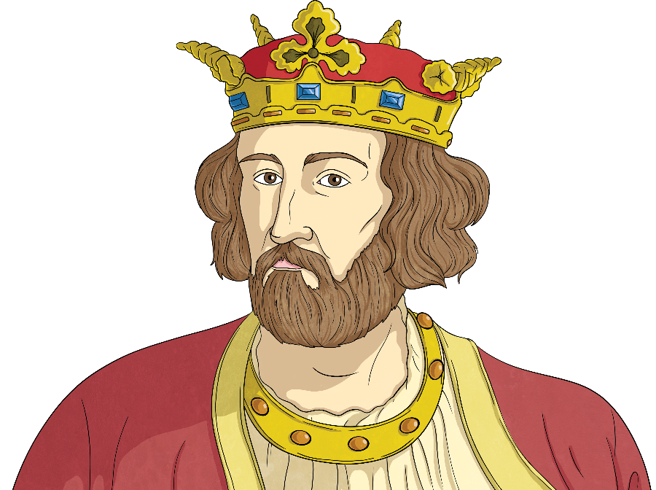
Edward the Elder
After the death of King Alfred the Great, his eldest son, Edward the Elder, took the throne.
Edward ruled from AD 899 - 924.
During Edward’s reign, his older sister, Aethelflaed, married Aethelred, Lord of Mercia. Her marriage brought together Mercia and Wessex, the last Saxon kingdoms not taken by the Vikings.
Together, Edward and Aethelflaed started to take back much of England. The Saxons led raids into Viking-held lands and retaliation swiftly followed.
Striking back, at the Battle of Wednesfield, the northern Vikings were defeated and the balance of power altered.
Edward continued to bring parts of northern England under his control.
Edward died shortly after fighting in a rebellion of the Welsh and Mercian nobels.

Slide 10
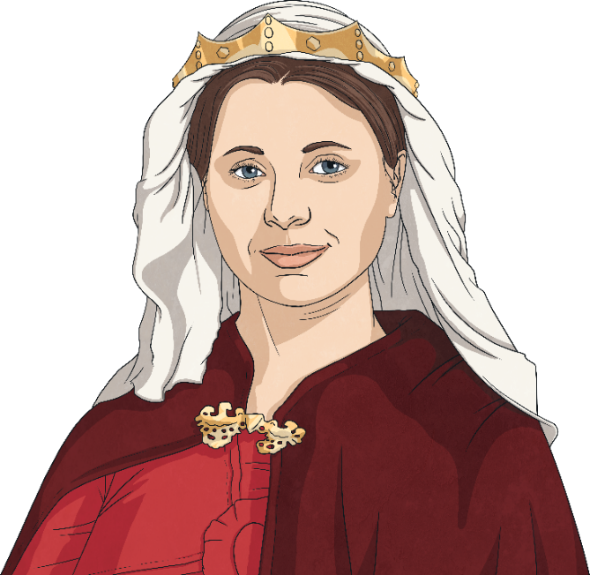
Aethelflaed, Lady of the Mercians
Aethelflaed’s reputation as a leader and negotiator grew as her husband’s health declined with old age. When Aethelred died, Aethelflaed became the ‘Lady of the Mercians’ as the tradition was that the king’s wife could not be called a queen.
Led by Aethelflaed, the Mercians defeated both Welsh and Viking raiders and took Derby. The Vikings of Leicester later surrendered along with a promise from York to obey her orders.
In AD 918, during great success, Aethelflaed fell ill and died.
She had one daughter, Aelfwynn, who, without opposition, took power of Mercia. Aelfwynn was quickly removed from control by Edward, as he was wary of Mercian power.
Aethelflaed’s success is often overlooked. The commonly used Anglo-Saxon Chronicles, written at the time in Wessex, concentrate on recording her brother’s successes. Different versions of the chronicles, written in different places, do give more recognition to her achievements.

Slide 11
King Athelstan
After Edward’s death, his son Athelstan (King Alfred’s grandson) became king. Athelstan is regarded as the first king of all Britain and he is remembered as a great leader.
Athelstan was king from AD 924-939.
During his reign he drove the Vikings back more and more and was able to claim control over a greater area of land.
In AD 927 Athelstan won back the kingdom of York from the Vikings. He also established control over King Constantine from Scotland and the other Northern kings. The five Kings of Wales also agreed to pay tribute (money) each year to King Athelstan.

Slide 12
King Athelstan
At the Battle of Brunanburh in AD 937 Athelstan fought with his Viking and Welsh allies to stop an invasion by the Scottish king.
Athelstan is know for forming good relationships with leaders from other countries. He married his four sisters to important rulers abroad which helped strengthen Britain’s position overseas. He also had strong links with religious leaders and he founded many churches.
Do you think Athelstan was as ‘great’ as King Alfred?
Think about the actions and achievements of King Alfred and King Athelstan.
What important or influential things did the two kings do?
Why are they such important historical figures?

Slide 13
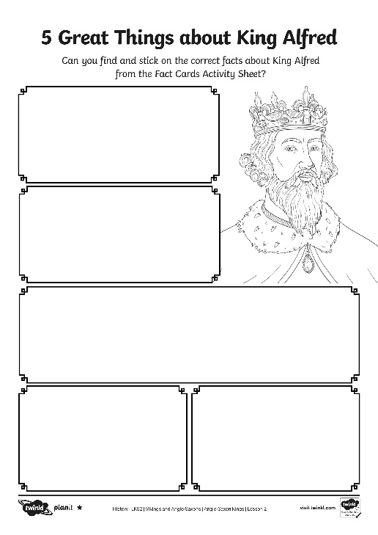
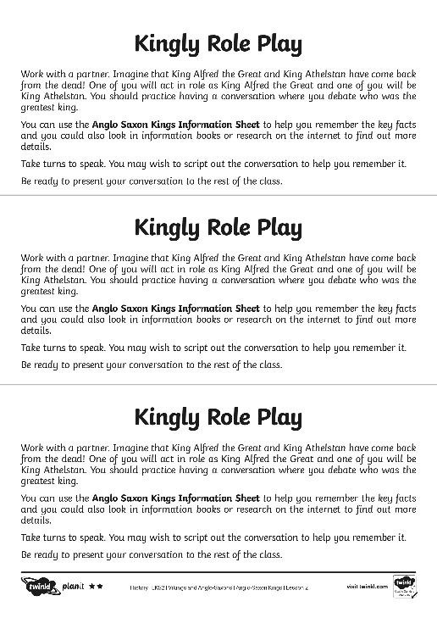
King Activities
Use the information you have learnt in the lesson to complete the activity about King Alfred and King Athelstan and their fight against the Vikings.
You may want to use information books or the internet if they are available to help you find more information.

Slide 14
Aim
I can compare the significance of some Anglo-Saxon kings during the Viking period.
Success Criteria
I can identify key facts about some Anglo-Saxon kings.
I can demonstrate my understanding of the significance of some Anglo-Saxon kings.
I can compare the similarities and differences between some Anglo-Saxon kings.

